Slide 1


EMPLOYEE COMPENSATION
ANALYTICAL TOOLS AND DECISION MAKING (DAB-103)
Presented By:
Team 6

Slide 2

AGENDA
TEAM MEMBER INTRODUCTION
BACKGROUND STATEMENT
PROBLEM STATEMENT
PROJECT PROPOSAL
ANALYSIS QUESTIONS
DESCRIPTIVE STATISTICS
EXPLORATORY DATA ANALYSIS (Cleaning & Transformation)
DATA VISUALIZATION
CONCLUSION
RECOMMENDATIONS
RESOURCE LINK
DATASET LINK

Slide 3







MEET OUR TEAM
Abigail Dsilva
Srinivas Venuvanka
Henil Rojvadiya
Krupali
Vyas
Nirali Khirsaria
Sruthi Gangadharan

Slide 4



BACKGROUND STATEMENT
Employee compensation refers to the total package of pay and benefits that an employer offers to its employees in exchange for their work. This includes not only wages or salaries, but also benefits such as health insurance, retirement plans, and paid time off. Employee compensation is a crucial factor in attracting and retaining talent, maintaining employee morale, and ensuring that employees are fairly rewarded for their work.

Slide 5

PROBLEM STATEMENT
To analyze and understand the compensation structure for different job classifications, departments, and agencies, identify any anomalies or discrepancies in compensation, and provide insights for potential improvements or adjustments to the compensation structure in the City and County of San Francisco, USA.

Slide 6

PROJECT PROPOSAL
The purpose of this proposal is to use the "Employee Compensation" dataset to conduct research on the compensation structure of the City and County of San Francisco. This research will help identify any disparities in pay and benefits among different employee groups, as well as provide insights into the overall compensation structure of the city.

Slide 7

ANALYSIS QUESTIONS
Which organization group is spending more time at work (doing overtime)?
Percentage of Employee Compensation received in all Departments?
Are employees getting paid for time and overtime what they are contributing towards their job?
Is Salary Distribution/ benefits same across all the years?

Slide 8
DESCRIPTIVE STATISTICS

Slide 9
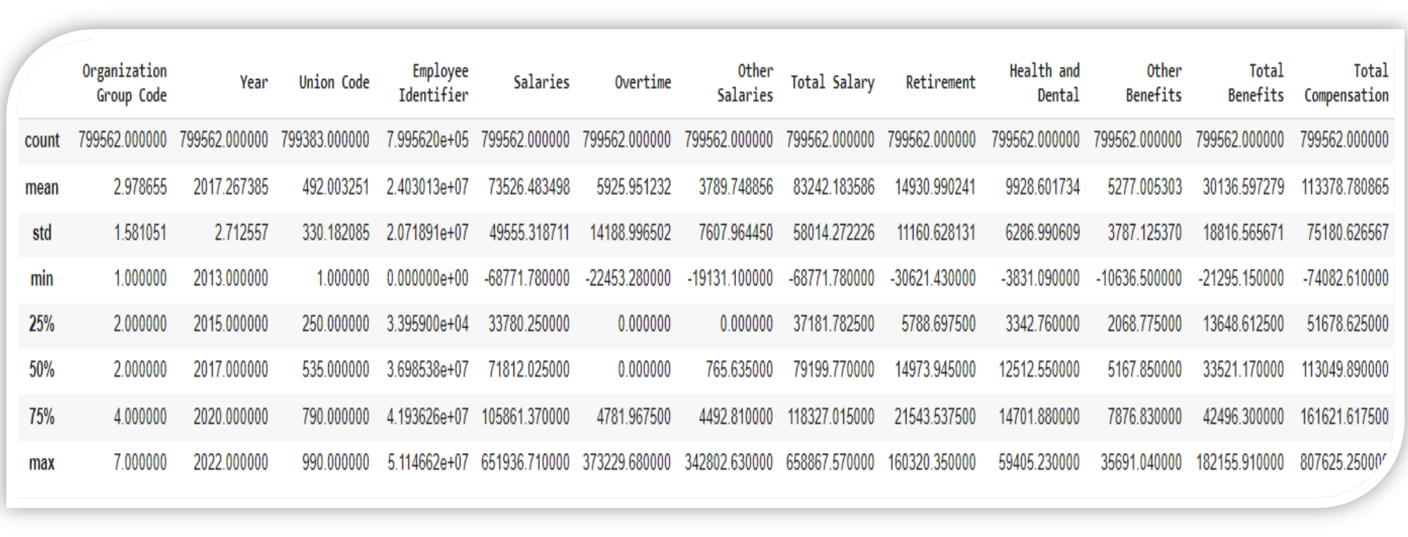

Slide 10
EXPLORATORY DATA ANALYSIS
Data Cleaning and Transformation

Slide 11
NUMERIC
Org. Group code Year
Union code
Over time
Health and dental Other benifits
Total compensation
Employee Identifier Salaries
Other salaries
Total salary
Retirement
Total Benefits

Slide 12
CATEGORICAL
Job family code
Job
Job Code
Year type
Org. group
Dept. code
Department
Union
Job family

Slide 13
EDA
HOW WAS THE DATA COLLECTED?
The Employee Compensation dataset available on Data.gov
The dataset is created and maintained by the San Francisco Controller's Office, which collects and reports compensation data for all employees of the City and County of San Francisco.
The data is collected and reported in compliance with relevant laws and regulations, such as the San Francisco Sunshine Ordinance and the California Public Records Act. The dataset is updated annually and is publicly available on Data.gov for anyone to access and analyze.

Slide 14
EDA
THE INCLUSION CRITERIA
We are considering almost all the features from the dataset, except the Job Code, Department Code, Union Code, Employee Identifier, Job Family Code and Organization Group Code.
We are excluding them because these are unique identifiers and not useful for our analysis.

Slide 15
EDA
IDENTIFYING OUTLIERS
We identified outlier data in total salary, retirement and total compensation feature from the dataset and dropped it.

Slide 16
EDA
CHECKING IMBALANCED DATA AND MISSING RECORDS
There is no imbalanced data in the chosen dataset.
However, we found 200 records missing records and dropped those records from the Dataset.

Slide 17
EDA
PRELIMINARY VISUALIZATIONS FOR INDIVIDUAL FEATURES
We observed a trend in salaries, Health, Dental benefits and over-time of employees.

Slide 18
EDA - TRANSFORMATION
DROPPING UNUSED FEATURES FROM THE DATASET WHICH ARE NOT REQUIRED FOR OUR ANALYSIS
We observed that the columns
organization_group_code,employee_identifier,job_family_code,union_code and job_code were all having unique values which were not useful to us in our Analysis and Visualization. Hence, we dropped these features.

Slide 19
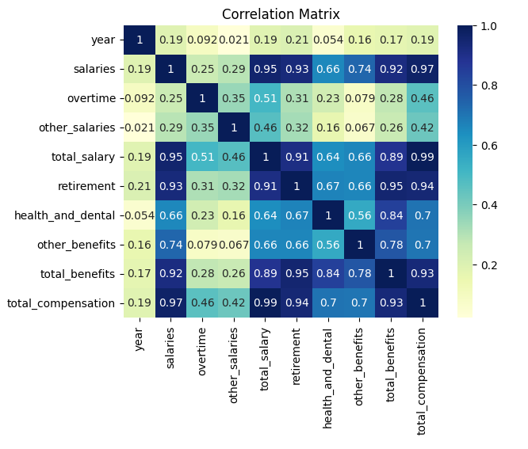
CORRELATION

Slide 20
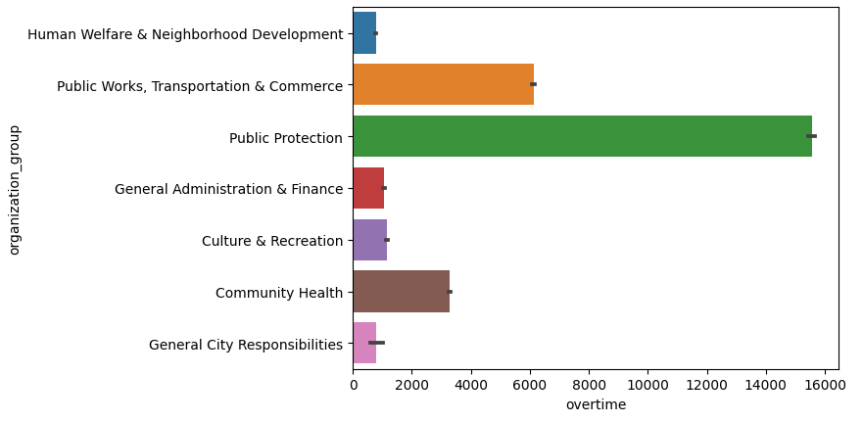
ANALYSIS QUESTIONS
Q1.Which organization group is spending more time at work (doing overtime)?

Slide 21
From the analysis, we noticed that the highest number of employees working overtime belong to the Public Sector organization.
We also noticed that there is a gradual increase in employees working overtime over the years with year 2022 showing a steep increase of 9000 hours across all organizations.

Slide 22
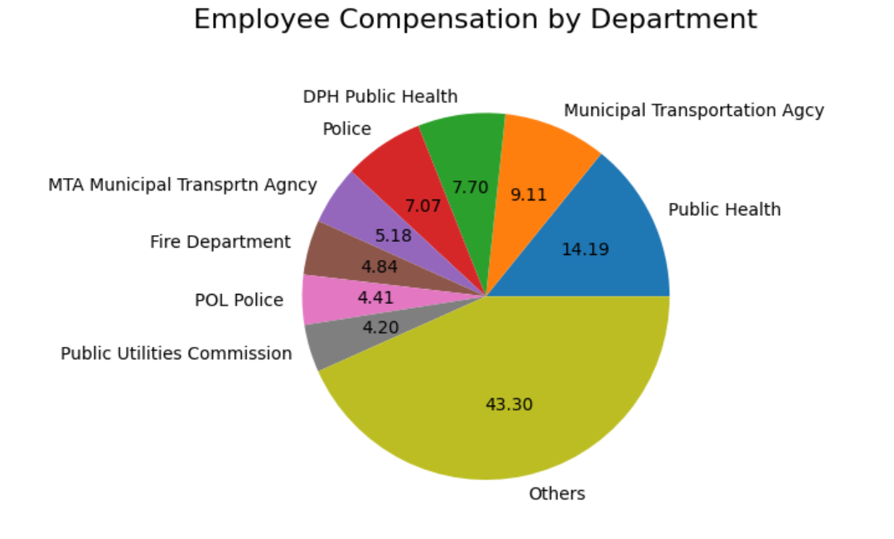
ANALYSIS QUESTIONS
Q2.Percentage of Employee Compensation received in all Departments

Slide 23
Employees in Public Health sector receive the highest percentage of compensation followed by Municipal Transportation Agency.
The rest of the departments receiving minimal compensation have been grouped together for a good visualization of the plot.

Slide 24
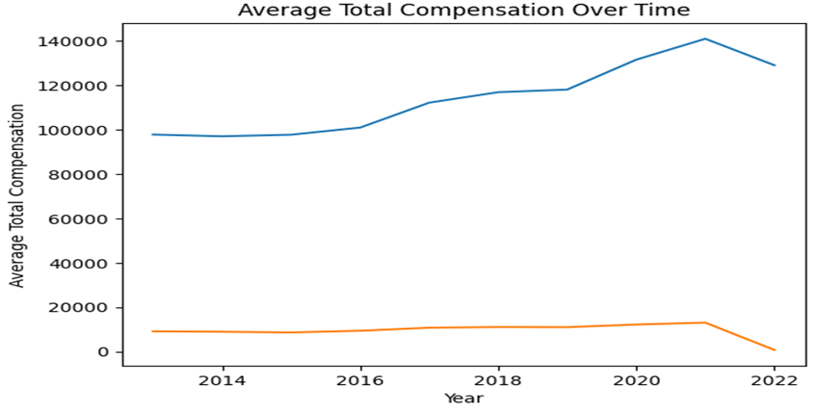
ANALYSIS QUESTIONS
Q3.Are employees getting paid for time and overtime what they are contributing towards their job?

Slide 25
A gradual increase is seen in the salary compensations of the employees in all departments in the years, however, from 2021 we see that the employees are receiving less salary compensations compared to the previous years which continues in the year 2022.
This raises a concern since we see employees increasing their over time in the respective jobs but there is a decrement in the salary compensations and benefits received.
Many factors may have contributed to this issue.

Slide 26
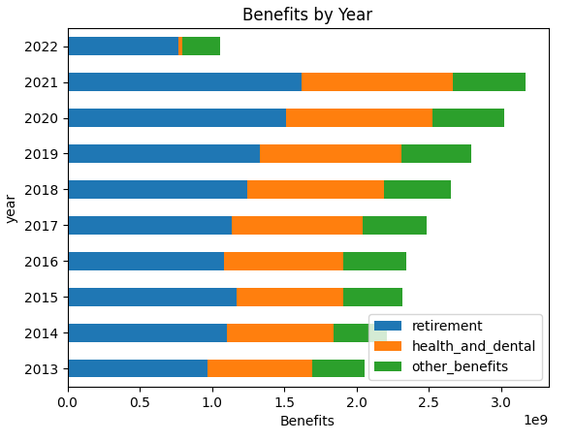
ANALYSIS QUESTIONS
Q4. Is Salary Distribution/ benefits same across all the years?

Slide 27
We see that the maximum number of hours spent working extra were in the year 2022, but we notice that the salaries and benefits paid the same year were very less compared to the previous years.

Slide 28
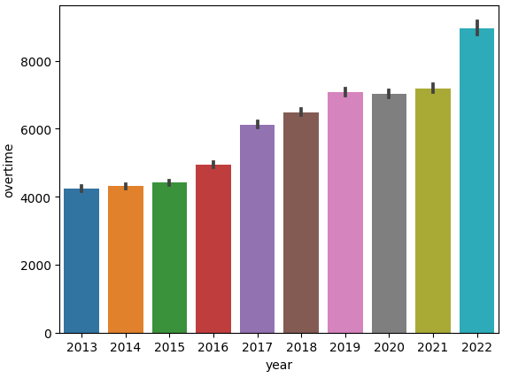
Additional Information: Over Time vs Year

Slide 29
Conclusion
From the analysis,
Employees in Public Health sector receive the highest percentage of compensation followed by Municipal Transportation Agency.
Highest number of employees working overtime belong to the Public Sector Organization.
There is a gradual increase in employees working overtime over the years.
Maximum number of hours are spent working extra, but the salaries and benefits paid is very less in comparison.

Slide 30
Review the compensation and benefits structure of the Municipal Transportation Agency to ensure that employees are being appropriately compensated for their work.
Recommendations
The Public Sector Organization should consider implementing policies and procedures to manage overtime hours and ensure that they are fairly compensated for their work.
The organization should review their hiring practices to ensure that they have sufficient staff to avoid the need for excessive overtime hours.
The organization should conduct a review of their salary and benefits structure to ensure that it is competitive with other employers in the industry.
The organization should consider providing additional benefits, such as flexible working arrangements or additional time off, to compensate for the extra hours worked by employees.

Slide 31
RESOURCE LINKS
GITHUB
https://github.com/henilrojivadiya/Team06EmployeeCompensation
DATASET
https://catalog.data.gov/dataset/employee-compensation

Slide 32
THANK YOU

